Slide 1
House-Hold Rental Team-Alpha Project Review 3: Backend Presentations CPSC 5240-01 Software as a Service By, Amogha Lavanya Sravya
An e-commerce website which provides a platform for renting household goods, electronics, fashion items, furniture, art-painting, cars, bikes etc.

Slide 2










LOGIN
Welcome User1
Images of the Item
Confirmation Page
UserName:
Cart
Your Account
Rent Item
Logout
Cost
Name of the Item
Password:
Categories
Order Placed Successfully…..!!
Pickup Location
LOGIN
Household
Car
Furniture
Fashion
Electronics
Bikes
Art-Paintings
New user?
Car 1
Condition of the item (Good)
Item Name
Owner Name
Owner Location
Cost
Forgot Password?
Pick up Date
Return Date
Photos
Complete Description of the Item
SIGN-UP
UserId:
Password:
First Name:
Last Name:
Owner Details
Item Name
Owner Name
Owner Location
Cost
Pick up Date
Return Date
*Address:
City:
Car 2
State:
Add to Cart
ZipCode:
Reviews…………
* Email:
*Phone Number:
1,2,…….14,15 - Pagination
NEXT
Security Questions:
Cart Items
User Name
Address
SUBMIT
As a Owner of the Item
Electronics
Bikes
Cars
Furniture
Item Name
Item 1 Image
Item Name
Owner Name
Category
Condition
Qty
Cost
Days
RESET PASSWORD
Excellent
Good
Average
Not Bad
Description
Price per day
Delete
Save for later
UserId:
Item 1 Image
Item Name
Owner Name
New Password:
Photos Upload
Reenter Password:
Click to upload
Qty
Cost
Security Questions:
Days
Save
Delete
Confirm and Check out
SUBMIT
Edit
Delete
Save for later

Slide 3
User Stories Done
Login Functionality
As a User I should be able to enter username and password and should be able to login.
As a new User I should be able create new account.
As a User I should be able to reset my password if I have forgotten.
Signup Functionality
As a new User I should be able to enter all my details like username, address, phone number, email etc.
As a user I should be able to set my own password and userId.
Forgot Password Functionality
As a User If I have forgotten my credentials then I should be able to reset my password.

Slide 4
Home/Listing Functionality
As a user I should be able to see all household items which are available for renting.
As a user I should be able to sort based on category.
Product Description Page Functionality(As a owner)
As a User I want to add the item to the cart so that I can rent it.
Confirmation Page Functionality
User gets a confirmation Message so that they
can be assured order was placed along with the order details
User Stories
Done

Slide 5
Product Description page Functionality(As a Renter)
As a User I want to add the item to the cart so that I can rent it.​
As a user I want to see all the details of the item so that I can decide on renting it.
Cart Page Functionality
As a User I want to see the final list of items I want to rent so that I can confirm before checkout.
As a User I want to delete an item in my cart so that I can remove it from my list.
As a User I want to save an item so that I can get back to it Later.
As a User I want to checkout the items so that I can collect my items from the owner.
User Stories
Remaining

Slide 6
User Stories Remaining
As a Owner I want to upload the item I have so that I can rent it to others.
As a Owner I want to edit the details of the Item So that I can update any changes.
As a Owner I want to delete the Item so that it is not available for anybody to rent it.
As a User I want to see the reviews and ratings so that I can be assured of the item quality.
Product Description page Functionality(As a Renter)
As a User I want to know the owner details so that I can gain more trust.

Slide 7
SEQUENCE DIAGRAM FOR LOGIN AND RESET PASSWORD

Slide 8
SEQUENCE DIAGRAM FOR HOUSE HOLD RENTAL APPLICATION

Slide 9
DATA MODEL DIAGRAM
USER
ITEM
ITEM RENTING DETAILS
CART
- username : String
- password : String
- firstName : String
- lastName : String
- address :String
- city :String
- state :String
- zipCode :int
- phoneNumber : int
-securityQuestionFirst :String
-securityAnswerOne :String
-securityQuestionsSecond :String
-securityQuestionsSecond :String
- id : objectId
- itemName :String
- condition :String
- description :String
- pricePerDay : int
- itemImage : String
- username : String
- categoryName : String
- isRented : Boolean
_id : ObjectId
rentalDays : int
rentalCost : int
Rating :int
itemID : objectId
username : String
fromDate : String
toDate : String
Quantity :int
- _id :objectID
- itemrentalId : objectId
- totalCost : int
1
N
1
1
+ insertItemToCart()
+ getCartDetails()
+ updateCartDetails()
+ deleteCartDetails()
+ itemDisplay()
+ itemCreation()
ORDER
+ getItemDetails()
-_id :objectId
username: String
cartId : objectId
orderStatus : boolean
+ login()
+ signup()
+ resetPassword()
+ getPasswordDetails()
+ insertToOrder()
+ getOrderDetails()

Slide 10
Technology Used
Front-end : HTML, JavaScript, JQuery
Bootstrap CSS
Middleware : MVC Java Spring (service Layer)
Backend : MongoDb
Tool used : Eclipse, Robo3T

Slide 11
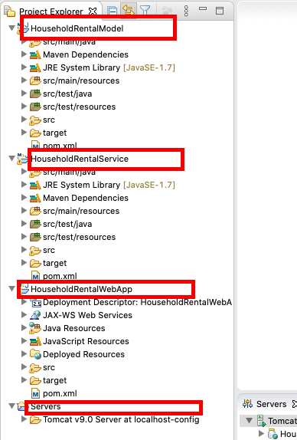
Code Organization
MVC Layer –
HouseholdRentalWebApp – Controllers and View
HouseholdRentalService – Service layer
HouseholdRentalModel – Model and Data layer

Slide 12
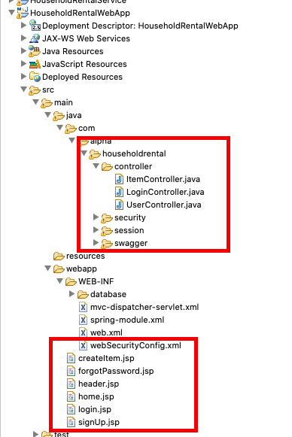
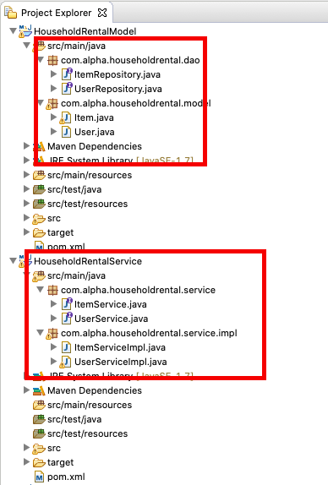

Slide 13
Code snippets - Controller

Slide 14
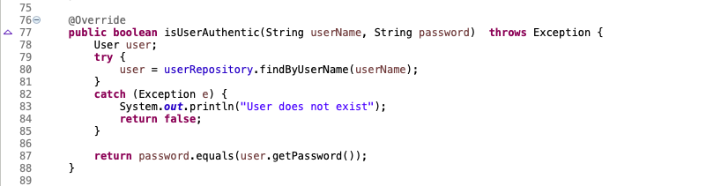
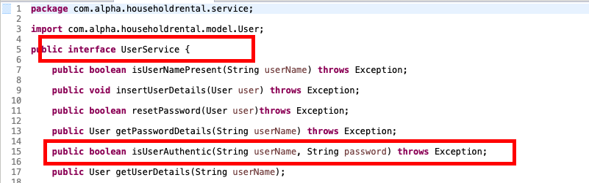
Service layer

Slide 15
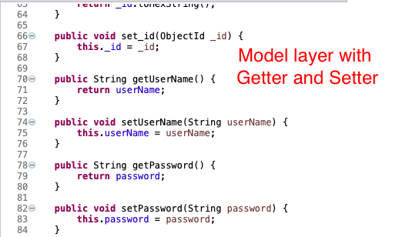
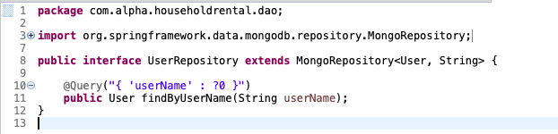
Model and Repository

Slide 16
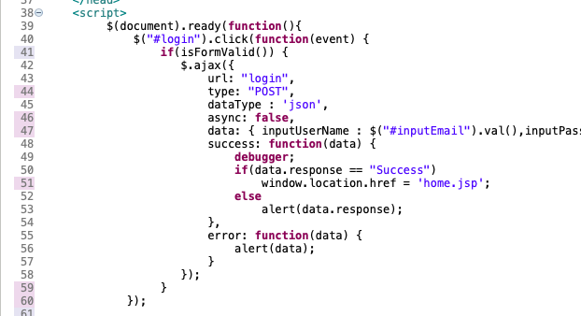
View - .JSP file

Slide 17
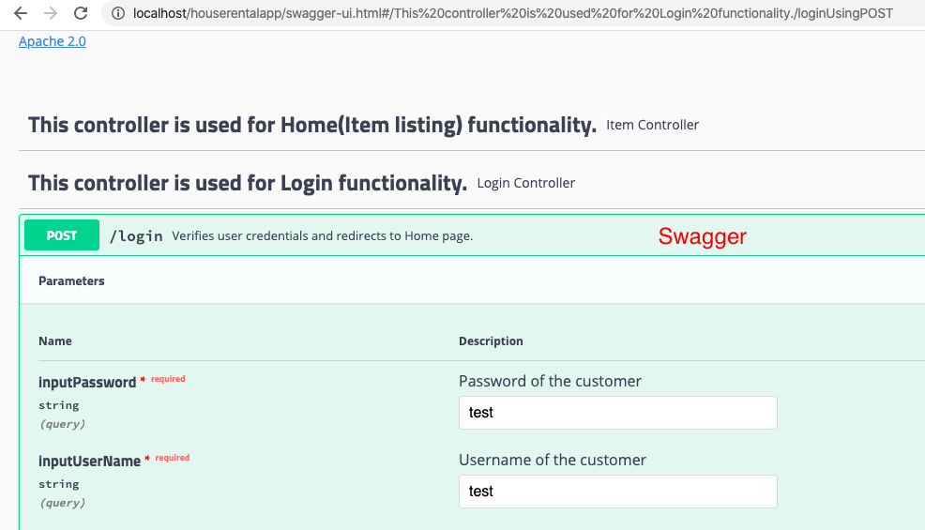
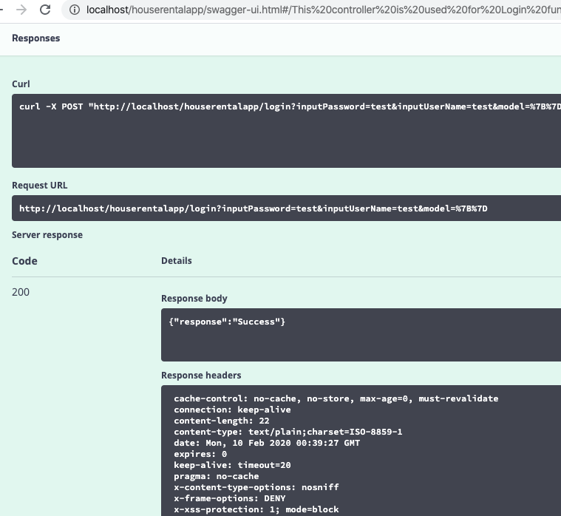
Swagger

Slide 18
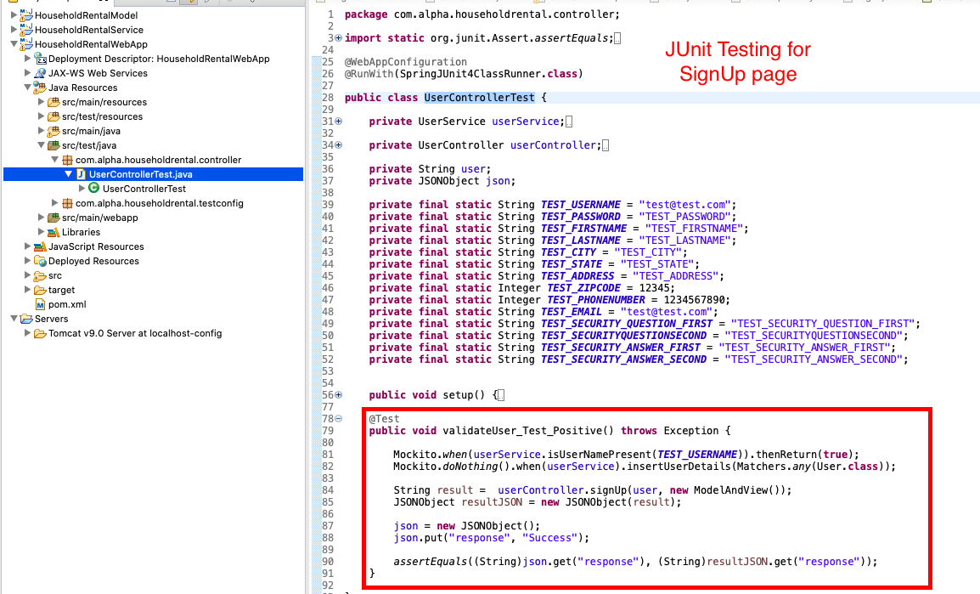
Junit – Unit Testing

Slide 19
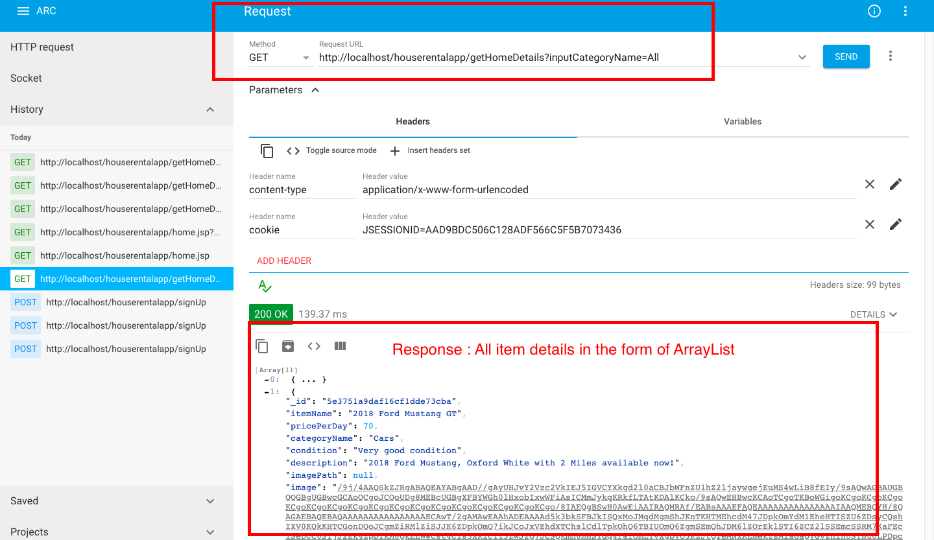
Request Response – Advanced Rest Client (ARC)

Slide 20
Thank you!!

